Slide 1
Statistical Inference of Medical Data: SARS-COV-2(Covid-19)
Presented by:
Bhoj Rani Soopal(A20378715)
Mrinalini LNU(A20348759)
Notes:
Bhoj Rani Soopal (A20378715), Mrinalini LNU (A20348759)

Slide 2
Introduction to Problem
Researchers and scientists are focused on developing an immediate treatment plan for the coronavirus(COVID-19). A medicinal cure remains a promising ailment to contain the severity of this pandemic. At the moment, the scientific community has not announced an actual drug to combat COVID-19. Hence, for our project we have simulated a random sample of data for our testing purposes.

Slide 3
Hypothesis testing problem
Medical World
Context
Problem statement
Currently, there is no available treatment plan for global pandemic SARS-COV-2.
Hypothetically, we test for a computer simulated dataset, whether there could be a medicine effective against this virus.
We simulate and showcase the hypothesis testing for our problem statement.
Notes:
The purpose of statistical inference is to draw conclusions about a population on the basis of data obtained from a sample of that population. Hypothesis testing is the process used to evaluate the strength of evidence from the sample and provides a framework for making determinations related to the population, i.e., it provides a method for understanding how reliably one can extrapolate observed findings in a sample under study to the larger population from which the sample was drawn.

Slide 4
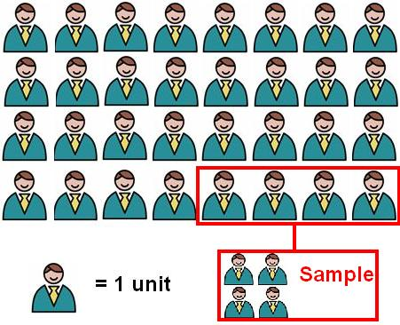
Our claim - Medicine reduces the recovery time
Notes:
From a sample of 100 patients, we found that the average recovery time to be 27 days. Is there sufficient evidence to support our claim?

Slide 5
Problem Statement
We assume that without a medicine, patients recover in a mean of 30 days. With our COVID-19 medicine, patients recover in a mean of 27 days.
Our purpose is to define a Hypothesis Test to validate from a sample size of 100 patients, if our medicine is effective against COVID-19. We perform T-test and Z-test for our Hypothesis to reach a conclusion about our data.

Slide 6
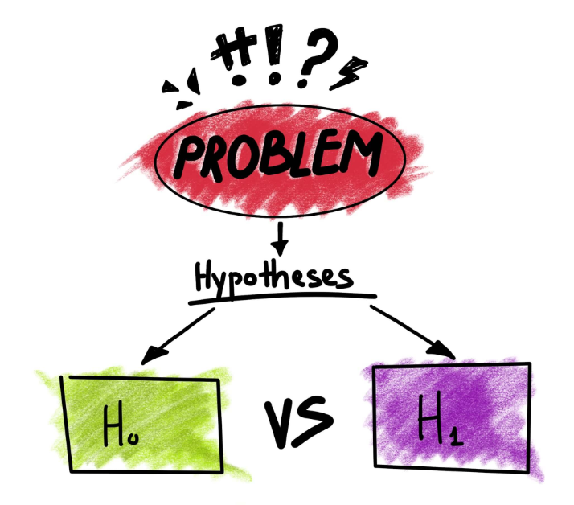
What is Hypothesis Testing?
Notes:
Hypothesis test: The purpose of statistical inference is to draw conclusions on the basis of data obtained from a sample of that population.
For our case,
H0 : The medicine has no effect on recovery time and is ineffective
H1: The medicine reduces recovery time and is effective

Slide 7
Z-Test
Notes:
We conduct a z-test assuming that the sample size used was >30, the data points were independent from each other, and the data were randomly selected from a population.

Slide 8
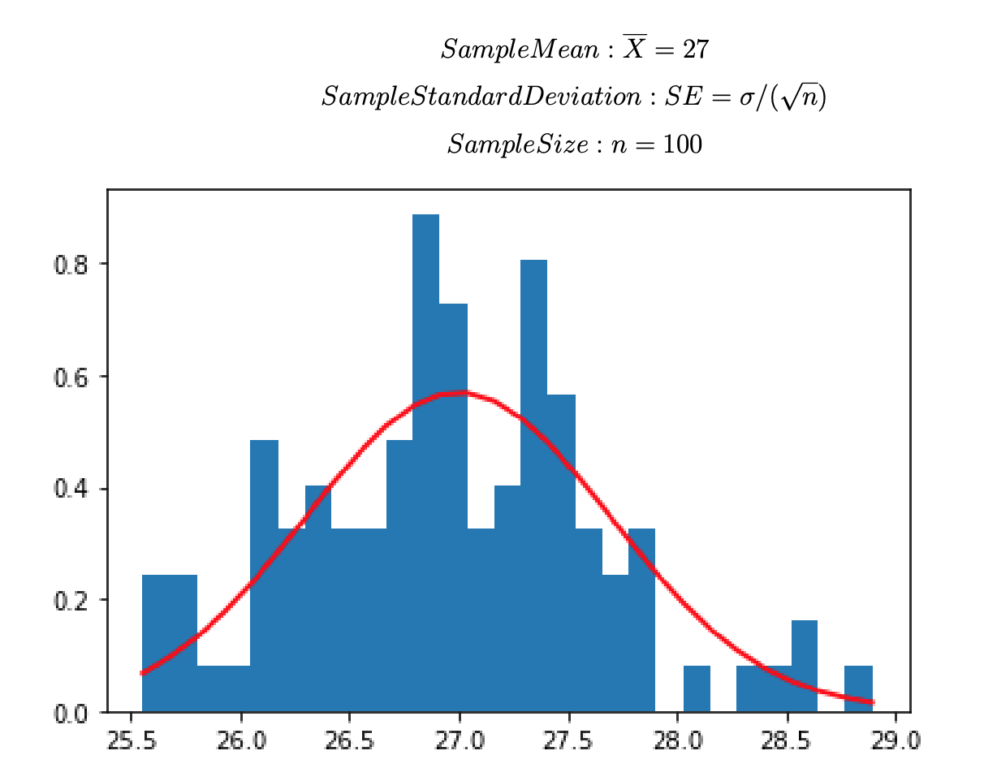
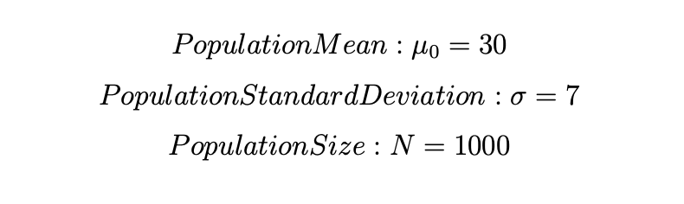
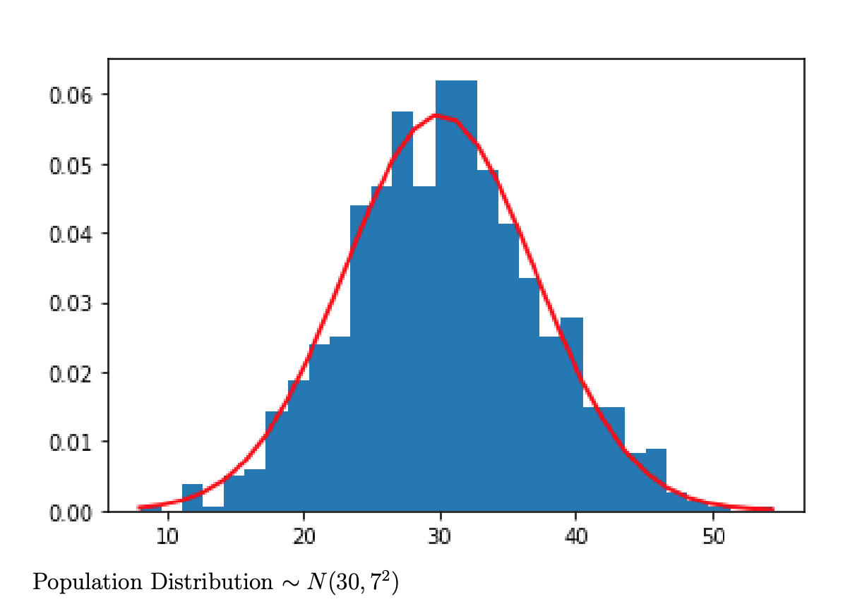
Notes:
We chose an alpha of 5%, find the critical value of z from the z-table (-1.645) and calculated the z-test statistics (-4.29). Since the calculated z-test value was < that z-critical value, therefore we rejected the H0. And, concluded that the medicine indeed reduces the number of days of recovery, and hence is effective.

Slide 9
Steps for Z-test
Step1:State the null hypothesis and alternative hypothesis
*H0: Medicine has no effect on recovery days, therefore it is ineffective
*HA: Medicine Reduces Recovery days, therefore it is effective
H0: mean=mu_0=30
HA: mean<30
Step 2: Define alpha and z-critical
α = 0.05
z_critical = -1.645 # derived from z table alpha level of 0.05 and one-tailed test
.
Notes:
It’s one sided(One-tailed), we we assume that no cases will ever get larger than population mean recovery days.
Z-critical is -ve, becaus’e its in the direction of alternative Hypothesis. Left Tailed

Slide 10
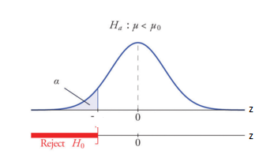

Step 3: Calculate Z-Statistic
mu_0=30,sigma=7#(Population)
x_bar = 27 ,N = 100,SE = sigma/np.sqrt(N) #(Sample)
Z_stat = (x_bar - mu)/SE =-4.29# Z Statistic
z_critical = -1.645
Step4: Compare the test statistic to the critical z -value and decide if you should support or
reject the null hypothesis.
Conclusion:
Z_stat<Z_critical, therefore we reject the Null Hypothesis.We can conclude that the medicine reduces number of days of recovery, hence it is effective.
-Z_critical

Slide 11
T-Test
Notes:
Similarly, we conducted a t-test assuming that our data has a normal distribution and the standard deviation of the population parameter is unknown.

Slide 12
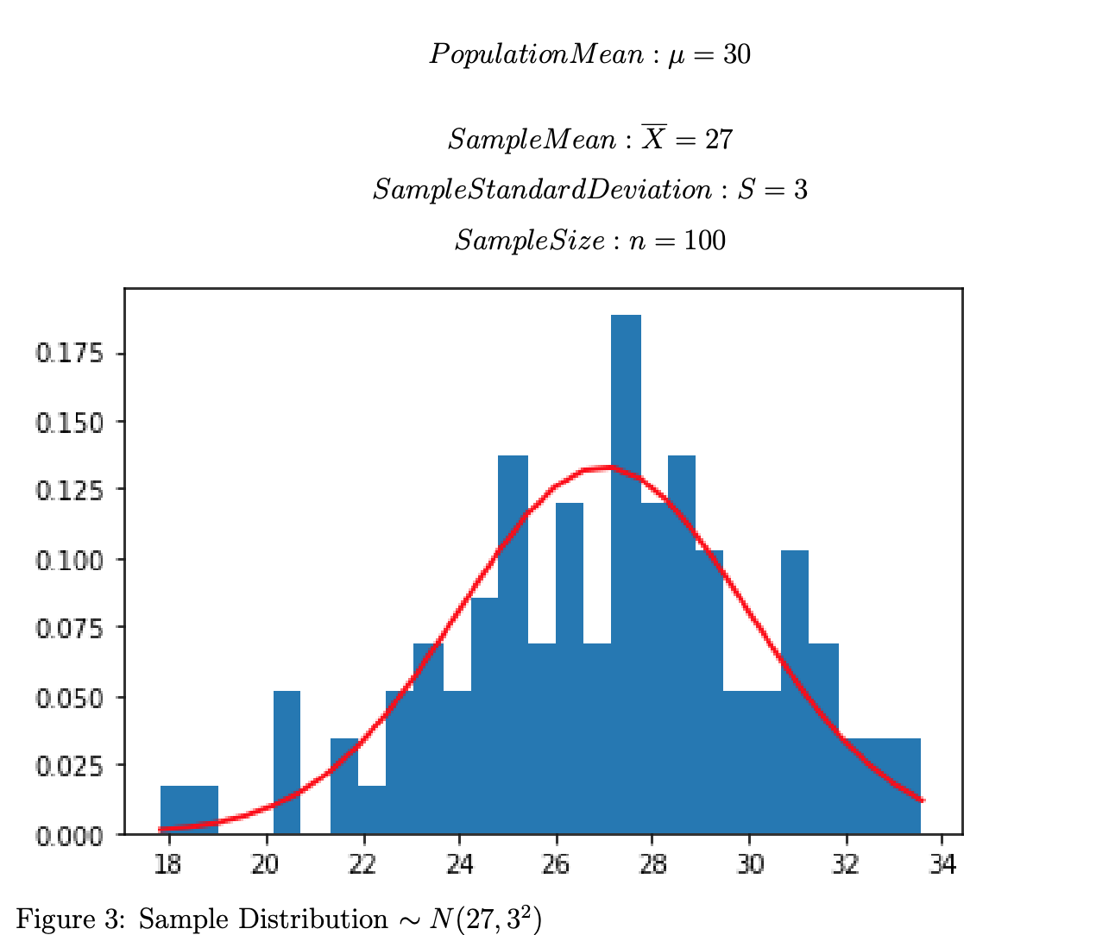
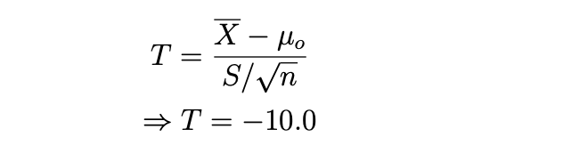
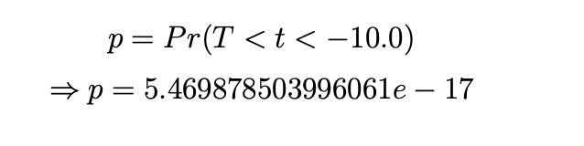
T-Statistics:
P-value:
Notes:
.Again, we chose a 5% alpha level, our degree of freedom is 99(100-1), and find the critical value of t from t-table to be -1.66. Our calculated t-stat is -10.0 and p-value a small value as shown. Usually, such a low p-value indicates decreased support for the null hypothesis; hence we conclude that we have enough evidence against the H0. Once again, our test shows that we can reject the H0.

Slide 13
Steps for T-test
Step1:State the null hypothesis and alternative hypothesis
*H0: Medicine has no effect on recovery days because of medicine X
*HA: Medicine Reduces Recovery days, therefore it is effective
H0: mean=mu_0=30
HA: mean<30
Step 2: Define alpha , degrees of freedom and t-critical
α = 0.05
df= n-1 = 99 #df=sample size-1
t_critical = −1.66039 # derived from t table alpha level of 0.05, df=99 and one-tailed test
.
Notes:
It’s one sided(One-tailed), we we assume that no cases will ever get larger than population mean recovery days.
t-critical is -ve, becaus’e its in the direction of alternative Hypothesis. Left Tailed

Slide 14
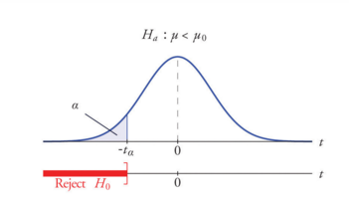
Step 3: Calculate T--Statistic
mu_0=30,sigma=7#(Population)
x_bar = 27 ,N = 100,SE = sigma/np.sqrt(N) #(Sample)
t_critical = −1.66039
Step 4: Calculate p-value
Step5: Conclusion:
T<t_critical
p<α
Therefore we reject the Null Hypothesis.We can conclude that the medicine reduces number of days of recovery, hence it is effective.
Notes:
α = Significance Level = Probability of rejecting a true null hypothesis
p-value = Smallest value of α at which null hypothesis can be rejected (probability you would obtain a t-stat larger than what you got)
p<=α, Reject Ho
p>α, Fail to Reject Ho

Slide 15
Statistical Power Analysis
Notes:
Statistical power of a hypothesis test is simply the probability that the given test correctly rejects the null hypothesis.

Slide 16
Chosen significance level 5%
Power level of 80%
Significance Level
Effect Size
Power
Sample Size
Expected effect size: 80%
Required sample size of 25.
Notes:
Power analysis is built from the these building blocks. And, the idea of power analysis involved working with 3 out of 4 these metrics. Commonly, we design experiments with power level of 80% which translates to 20% probability of committing a Type 2 error.

Slide 17
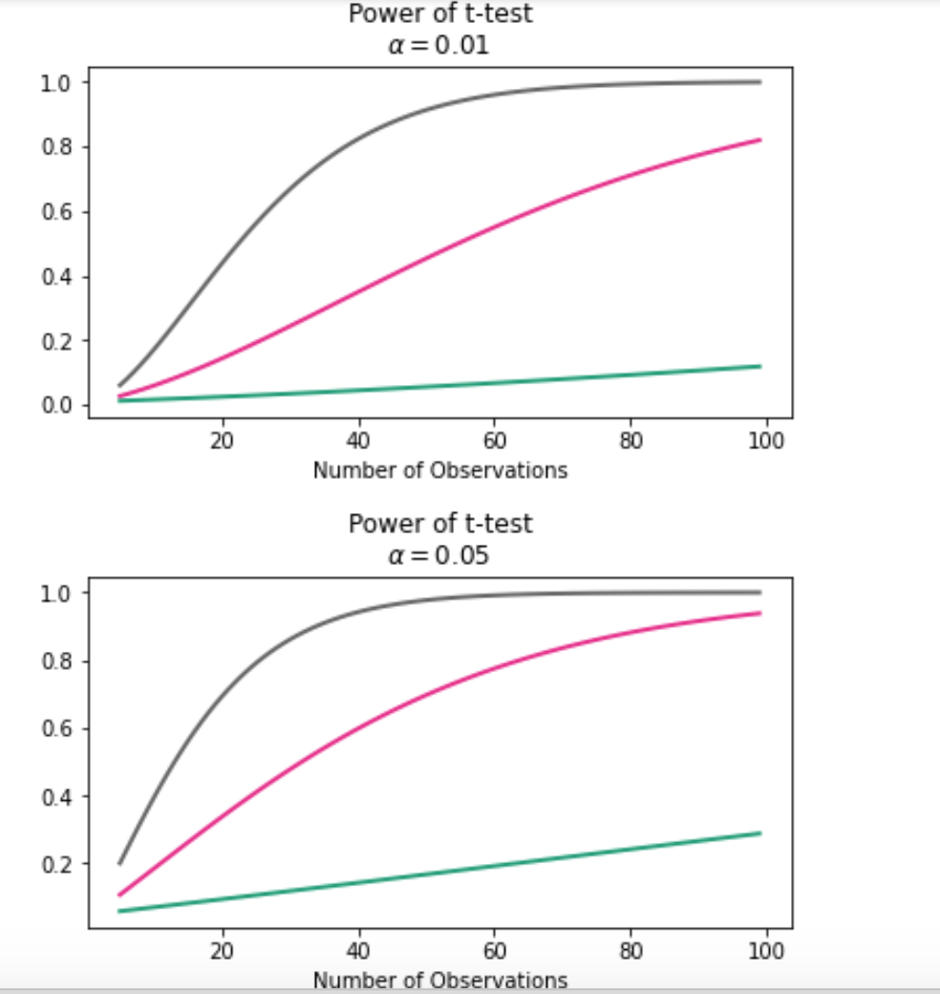
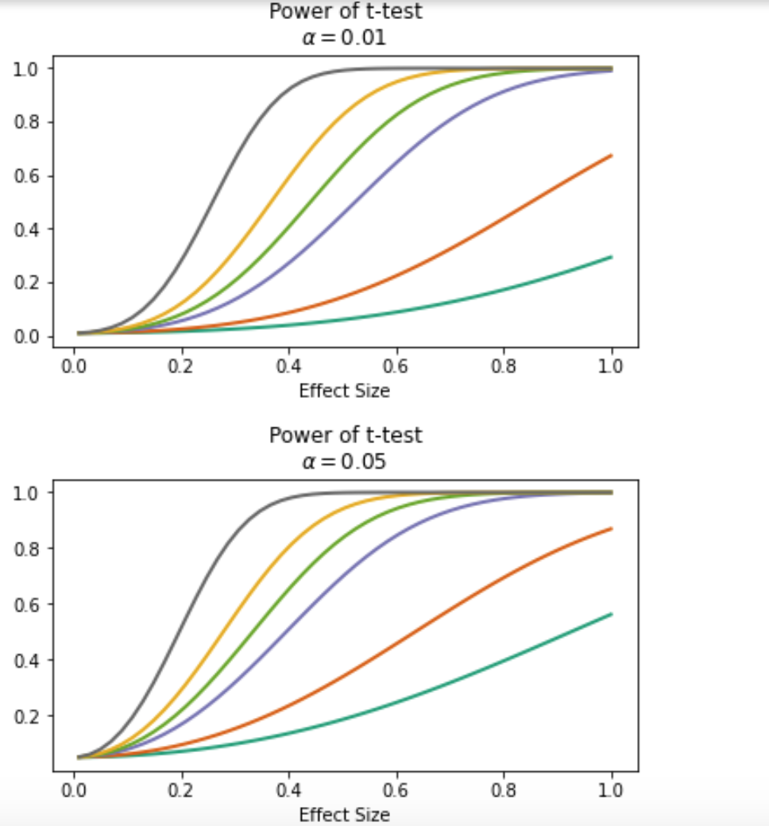
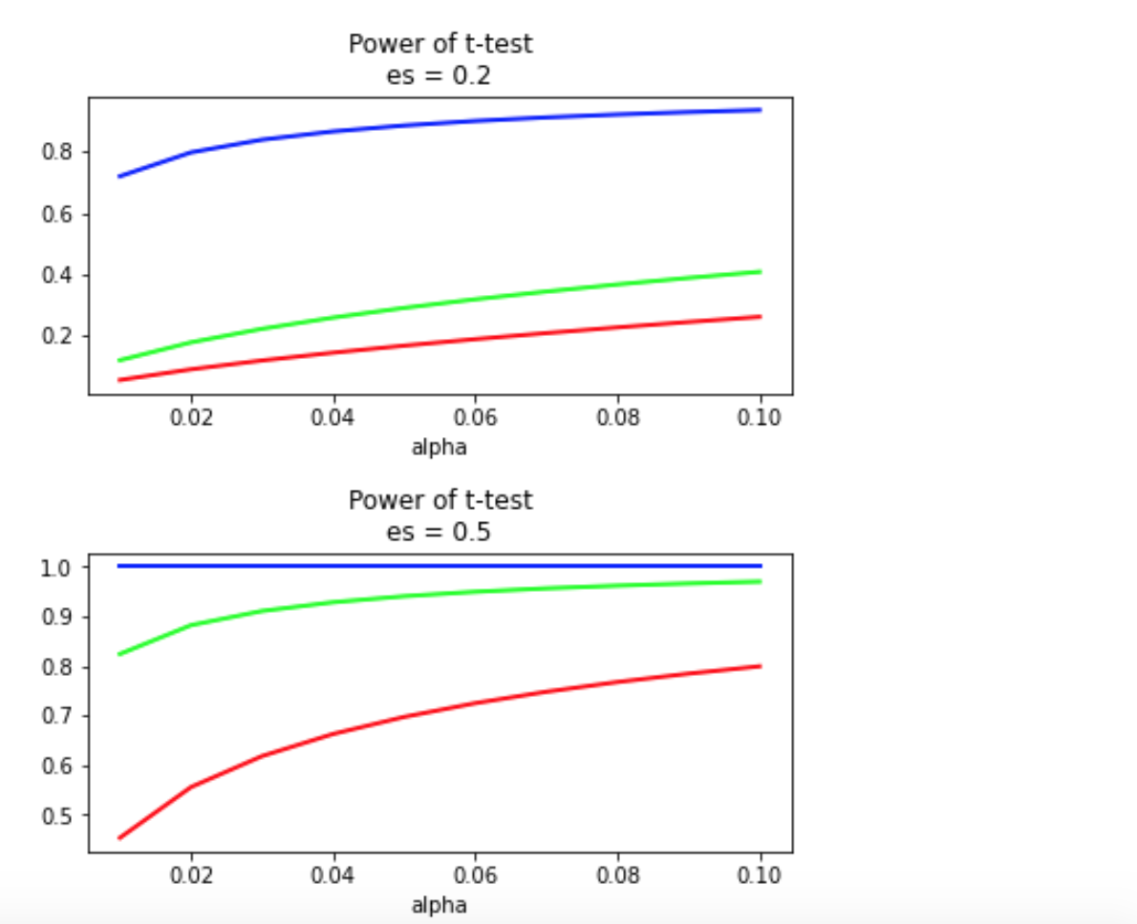
Power versus
Number of observations
Effect
Significance level
Notes:
We observe an increase in sample/effect size that results in an increase in power while the other parameters stay constant. And, we want that high power as it means low in type 2 error.

Slide 18
Confidence Interval
Notes:
A confidence interval is a range of values we are fairly sure our true value lies in.
We will use the confidence interval to determine how accurate our sample mean estimation is.

Slide 19
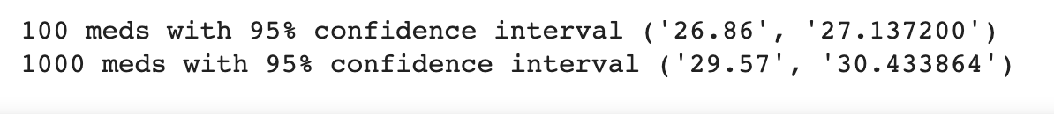
Results
Sample and population with 95% confidence interval
Notes:
From our results, we can note that a 95% confidence interval becomes narrower that is if we increase sample size from 100 to 1000.
Assuming that N is positive infinite, then we will have lim n->infinity sigma/sqrt(n) = 0. In other words, the confidence interval will become the sample mean!

Slide 20
Thank You
Any Questions?!

